Slide 1

Technology management decision-making
Dr. Xiaomin Yang
School of Engineering
Texas A&M University
College Station, TX

Slide 2
The course aims at enhancing leaders’ capabilities to
Make informed, value-adding decisions aligned with business strategy
1
Manage intuitive judgment under uncertain situations
3
Use data analytics tools to enable systematic decision-making processes
2
Notes:
Article: “Great leaders are great decision makers” by Larina Kase
When we think of what makes someone a great leader, one characteristic that comes to mind is decisiveness.
Leader often have to make challenging decisions, such as what direction to move their company in; whether to keep an employee, reposition them or let them go. Whether or not to share bad news with stock holders, and many other challenges.
Great leaders understand how to balance emotion with reason and make decisions that positively impact themselves, their employees, theirs customers and stakeholders and their organizations.
Making good decisions in difficult situations not small feat because these types of decisions involve change, uncertainty, anxiety, stress and sometimes the unfavorable reactions of others.
Great leaders also know when to move quickly and proceed with availability information , versus when to take more time and gather additional information.
When leaders opt to pursue additional information or avenues, they must also know when to stop.
While a large amount of data may be desirable in a perfect world,, the data gathering process can utilize too much time and the vast amount of date can also be paralyzing and take attention away from the big picture or key data points.

Slide 3
Common mistakes of business decisions
Unclear business guidance
Distracted by past decisions and sunk cost
Drown by data: unclear purpose
Lack of autonomy: too many cooks
Fail to EXECUTE
Too slow to adapt
Difficult to be decisive and deliberative
…
Notes:
Lose Focus: unclear business guidance
handle Past decisions and sunk cost: Escalation of commitment
Drown by data: unclear purpose
Lack of autonomy: too many cooks
Fail to EXECUTE: motivate collective actions
Too slow to adapt:

Slide 4

Systematic decision-making approach
1.Align business strategy and data integration
2. Identify and evaluate options and risks
3. Make intuitive judgment
Business strategy, value chain and data-driven culture
Decision tree, Simulation, Forecasting methods, and Optimization
Risking taking and intuitive judgment
Notes:
$7.4m

Slide 5
TCMT 612: Course outline
Module # | Module Title
1 | Roles of data analytics and human in decision-making
2 | Intuitive Judgment in decision making
3 | Intuitive Judgment in competitive environments
4 | Data-driven decision-making: decision tree method
5 | Align decision with business strategy
 | Mid-term project
6 | Predictive analytics - forecasting
7 | Analytical decisions – business optimization
8 | Uncertain analytics - simulation
9 | Integrate data analytics into business
 | Final exam

Slide 6

Decision-making process
Roles of data analytics, artificial intelligence and intuitive judgement in decision-making
Your risk-taking profile and leadership style

Slide 7
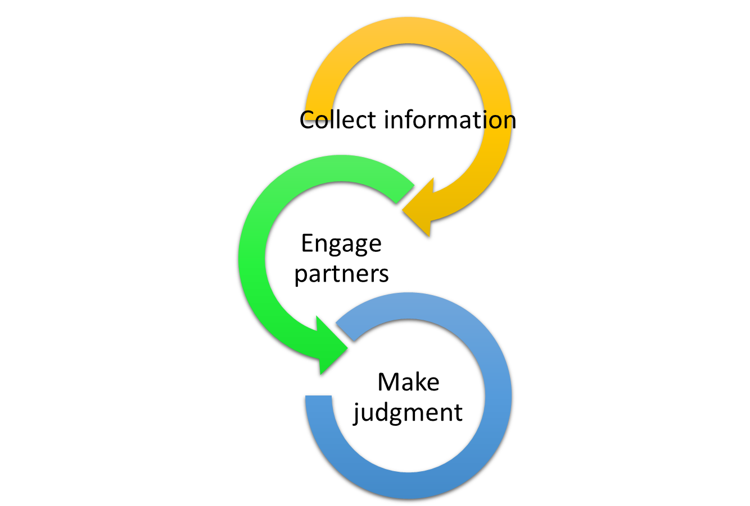
Intuitive judgment
Win-Win Negotiation Process
How to manage intuitive judgment biases
How to use a systematic approach to negotiation

Slide 8
Decision tree tool for decisions under uncertainty
How to develop decision tree models to evaluate and visualize different technology solutions under uncertain situations
How to estimate the value of a new technology solution
How to incorporate risk tolerance into decision analysis

Slide 9

Align decision with strategy
Leaders will learn:
Driving forces of an industry’s profitability
Your company’s competitive advantage
How to set strategic direction, objectives and performance criteria for your product/service portfolio

Slide 10

Data analytics for decision-making
Forecasting in predictive analytics: Predict short-term and long-term performance of a business, as well as draw insights from predictive analysis.
Optimization models for decision-making: Develop linear optimization models for business and create optimum solutions.
Simulating uncertain scenarios and decision options: Build simulation models and interpret results for informed decision-making, as well as understand automated simulation-optimization decision making process.
Notes:
Forecasting is a technique that takes data and predicts the future value of the data by looking at its unique trends.

Slide 11

Integrate data analytics into business
Assess the challenges of integrating data analytics into business decision making
Understand a business-driven computer-human collaboration model for Integrating

Slide 12

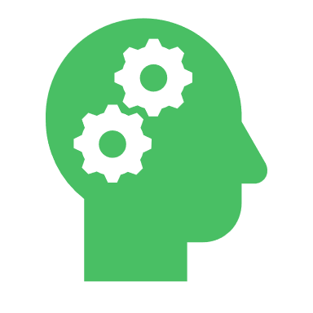

Expectation
Systematic Decision-making process
Business strategy
Data analytics
Intuitive judgment
Work hard
Have fun

